Slide 1
Basic Parametric Statistics Solutions 2-2
Ruth Nysen, PhD & Jeroen Wynen, PhD
Cristina Cametti

Slide 2
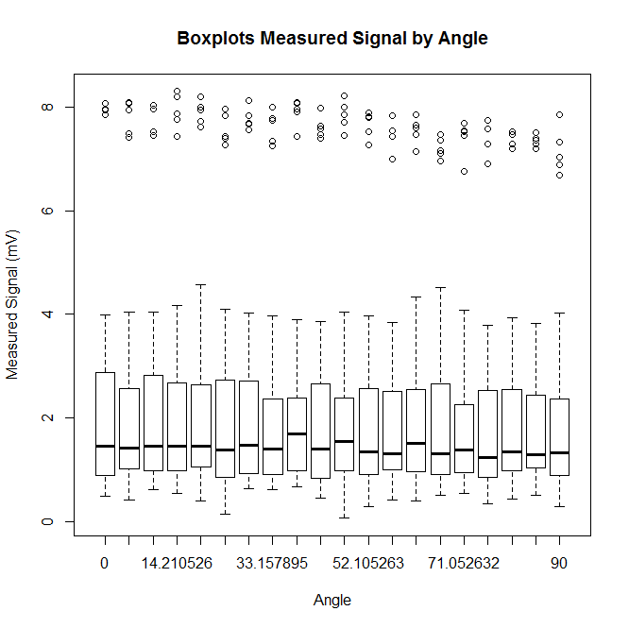
Question a: angle
Solutions 2-2
Very similar over angles

Slide 3
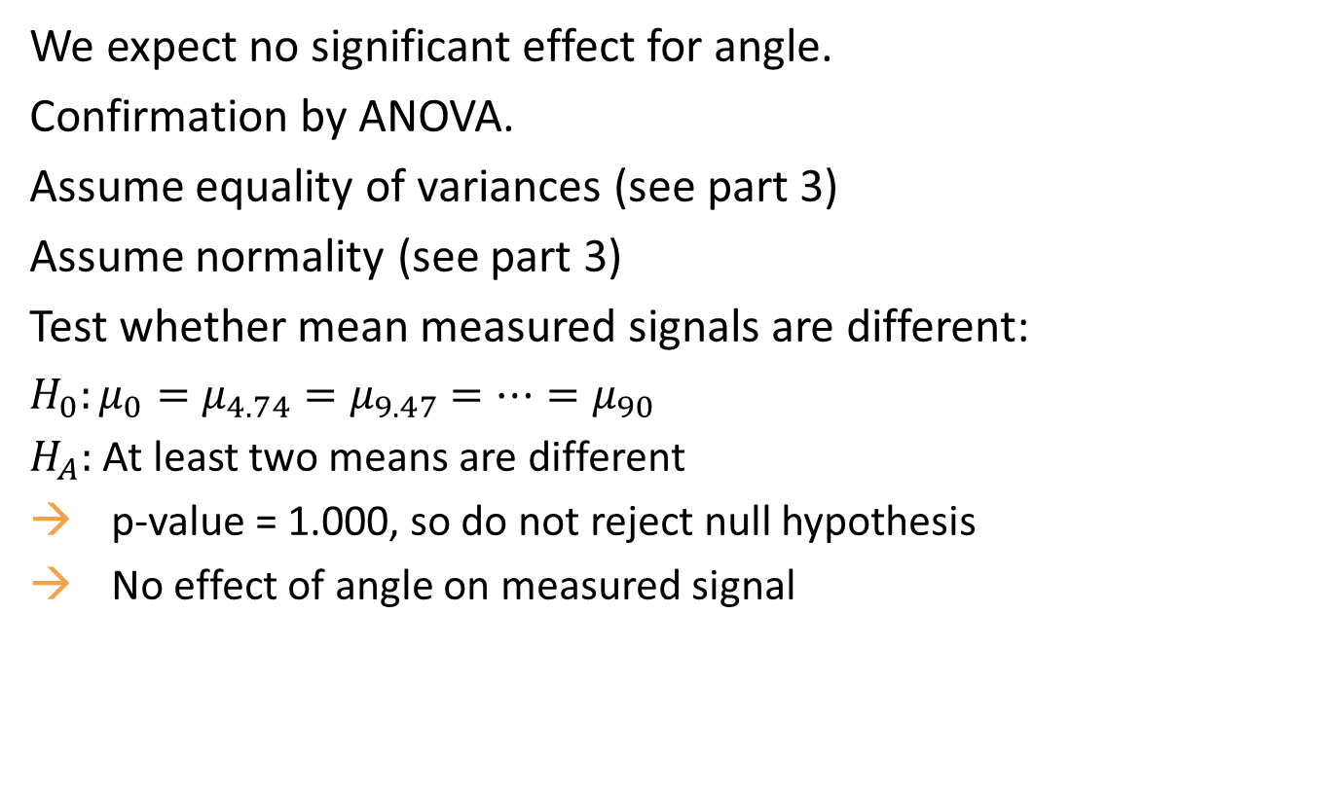
Question a (+d): angle
Solutions 2-2
We expect no significant effect for angle.
Confirmation by ANOVA.
Assume equality of variances (see part 3)
Assume normality (see part 3)
Test whether mean measured signals are different:
$H_{0}:μ_{0}=μ_{4.74}=μ_{9.47}=…=μ_{90}$
$H_{A}:$ At least two means are different
p-value = 1.000, so do not reject null hypothesis
No effect of angle on measured signal

Slide 4
Question a: frequency
Solutions 2-2
Confidence intervals (and other statistics): high similarity over frequencies
Differences observed are due to random noise, rather than systematic effect
Freq | Mean | sd | Confidence limits | Min | Median | Max
0.040 | 2.19 | 2.00 | [1.91;2.46] | 0.34 | 1.31 | 8.05
0.050 | 2.22 | 2.06 | [1.94;2.51] | 0.06 | 1.37 | 8.23
0.067 | 2.27 | 2.06 | [1.98;2.55] | 0.44 | 1.47 | 8.31
0.100 | 2.23 | 2.03 | [1.94;2.51] | 0.14 | 1.50 | 8.08
0.200 | 2.20 | 1.97 | [1.92;2.47] | 0.29 | 1.41 | 8.21

Slide 5
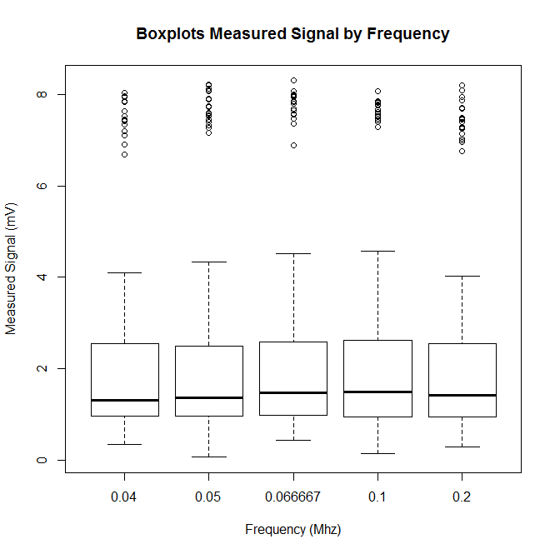
Question a: frequency
Solutions 2-2
Same observation as before: very similar over frequencies

Slide 6
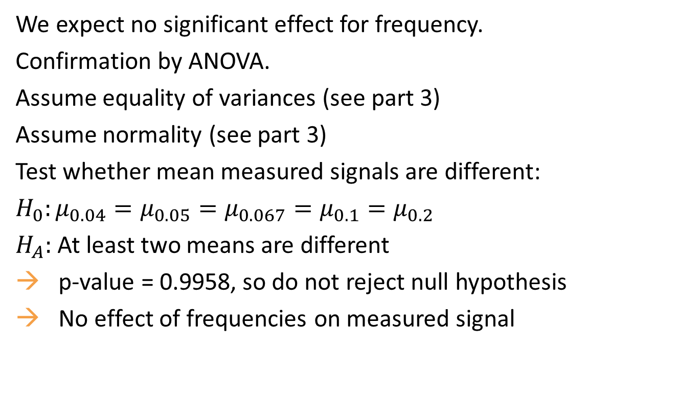
Question a (+d): frequency
Solutions 2-2
We expect no significant effect for frequency.
Confirmation by ANOVA.
Assume equality of variances (see part 3)
Assume normality (see part 3)
Test whether mean measured signals are different:
$H_{0}:μ_{0.04}=μ_{0.05}=μ_{0.067}=μ_{0.1}=μ_{0.2}$
$H_{A}:$ At least two means are different
p-value = 0.9958, so do not reject null hypothesis
No effect of frequencies on measured signal

Slide 7
Question b
Solutions 2-2
Distance | Mean | sd | Confidence limits | Min | Median | Max
10 | 7.62 | 0.35 | [7.55;7.68] | 6.68 | 7.58 | 8.31
20 | 3.75 | 0.25 | [3.70;3.80] | 3.21 | 3.74 | 4.57
30 | 2.56 | 0.26 | [2.51;2.61] | 2.02 | 2.55 | 3.31
40 | 1.88 | 0.24 | [1.83;1.93] | 1.07 | 1.87 | 2.45
50 | 1.51 | 0.30 | [1.45;1.57] | 0.81 | 1.50 | 2.20
60 | 1.27 | 0.26 | [1.21;1.32] | 0.68 | 1.28 | 1.91
70 | 1.09 | 0.26 | [1.04;1.14] | 0.48 | 1.09 | 1.90
80 | 0.88 | 0.27 | [0.83;0.94] | 0.06 | 0.90 | 1.55
90 | 0.84 | 0.23 | [0.80;0.89] | 0.35 | 0.83 | 1.45
100 | 0.80 | 0.24 | [0.75;0.85] | 0.14 | 0.78 | 1.42
Strong differences for small distances, less differences for higher distances

Slide 8
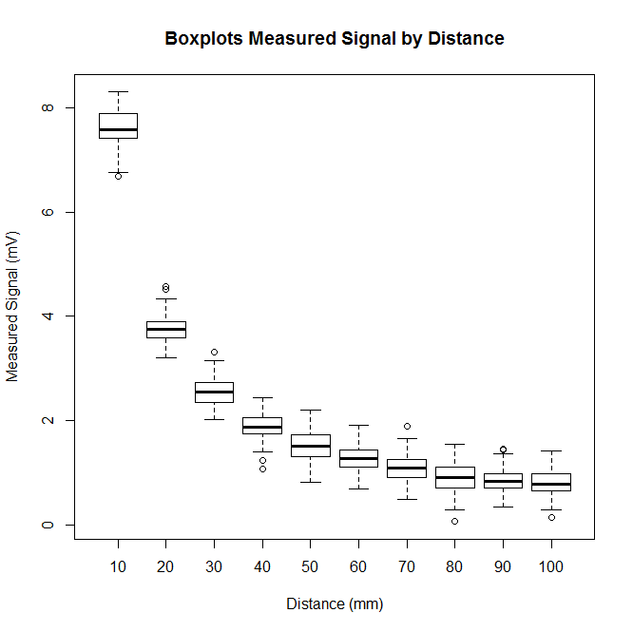
Question b
Solutions 2-2
Same observation as before: very large difference between 10 and 20 mm, after 80 mm: almost no change any more.

Slide 9
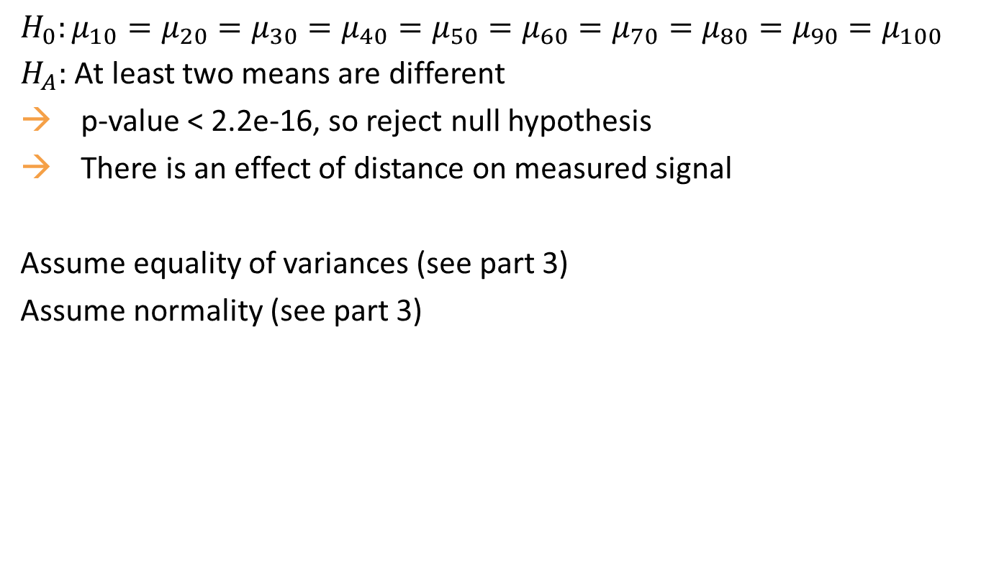
Question b (+d)
Solutions 2-2
$H_{0}:μ_{10}=μ_{20}=μ_{30}=μ_{40}=μ_{50}=μ_{60}=μ_{70}=μ_{80}=μ_{90}=μ_{100}$
$H_{A}:$ At least two means are different
p-value < 2.2e-16, so reject null hypothesis
There is an effect of distance on measured signal
Assume equality of variances (see part 3)
Assume normality (see part 3)

Slide 10
Question c
Solutions 2-2
Do 2x2 comparisons:
Balanced design, so Tukey can be used
Looking at boxplots, it is not clear if variances will be equal
We will both look at Tukey and Dunnet-Tukey-Kramer
Tukey correction:
All comparisons significant, except for
90-80 (p=0.9873)
100-80 (p=0.4426)
100-90 (p=0.9793)
This confirms previous observations that a perimeter of 80 mm is a good choice

Slide 11
Question c
Solutions 2-2
Dunnett-Tukey-Kramer correction:
For almost all comparisons, 0 is not in the confidence interval, so significant differences
Exceptions:
90-80: 95% CI = [-0.1570 ; 0.0758]
100-80: 95% CI = [-0.2019 ; 0.0336]
100-90: 95% CI = [-0.1523 ; 0.0652]
Same conclusion as before

